Slide 1
ATLAS/CMS/LCD RD53 collaboration: Pixel readout integrated circuits for extreme rate and radiation
3rd LHCC status report
May 25 2016
RD53 SPs: Jorgen Christiansen, CMS & Maurice Garcia-Sciveres, ATLAS on behalf of RD53

Slide 2
Reminder RD53
Focussed R&D program to develop pixel chips for ATLAS/CMS phase 2 upgrades and LCD vertex
Extremely challenging requirements for HL-LHC:
Small pixels: 50x50um² (25x100um²) and larger pixels
Large chips: ~2cm x 2cm ( ~1 billion transistors)
Hit rates: 3 GHz/cm²
Radiation: 1Grad, 2 10¹⁶ neu/cm² over 10 years (unprecedented)
Trigger: 1MHz, 10us (~100x buffering and readout)
Low power - Low mass systems
Baseline technology: 65nm CMOS
Full scale demonstrator pixel chip in 2016.
19 collaborating institutes and many Guests
Bari, Bergamo-Pavia, Bonn, CERN, CPPM, Fermilab, LBNL, LPNHE Paris, Milano, NIKHEF, New Mexico, Padova, Perugia, Pisa, Prague IP/FNSPE-CTU, RAL, Seville, Torino, UC Santa Cruz. (PSI has withdrawn as very busy with phase 1 pixel upgrade)
150 on collaboration Email list, 80 on RD53 NDA list (65nm TSMC technology access), 77 on RD53 guests list (ATLAS/CMS people involved in phase 2 pixel but not on chip design) 55 on serial power list (ATLAS/CMS people interested/working on serial powering)

Slide 3
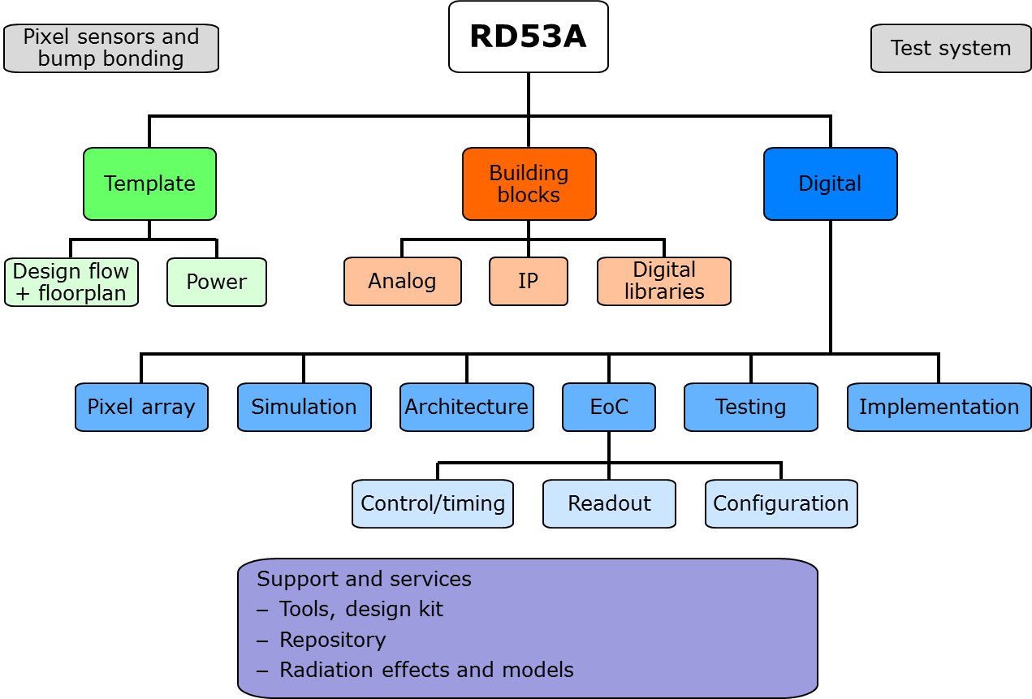
Internal organization
Before: R&D in working groups:
Radiation effects and rad hard design
Analog: Low power/noise/area analog front-ends
IP blocks: ADC, DAC, PLL, Modified digital library, etc.
Simulation and architecture: Simulation, Optimization, Verification, ,
IO: IO interface
Collaboration meetings across WGs
Now (from 1/1 2016): Focussed on large scale demonstrator
Project structure for RD53A demonstrator
Bring everything together to make working large scale chip
Radiation WG (still a critical issue)
Radiation WG
Analog WG
IP WG
Simulation WG
Top level and chip integration WG
I/O WG

Slide 4
Radiation effects
Radiation test and qualification of 65nm technology: 1Grad and 2 10¹⁶ neu/cm²
Radiation tests with X-rays, Cobalt source and 3Mev protons
Significant radiation damage above ~100Mrad (only critical for pixels)
New radiation effects made it difficult to reach clear conclusions
Two major “effects”
Radiation damage (transconductance) during radiation depends on: Device type, L, W, Bias, Temperature
Annealing effects depends on: Temperature, Time, Bias, Device type, L, W, Received dose Partial recovery (transconductance) or getting worse (V_{t} shift)
(Low dose rate effect)
Realistic to stand 500Mrad with conservative design approach
Cold detector: -20 - -10 ºC, Not getting hotter than room temperature while powered
Analog: Appropriately designed (large transistors) will only have small radiation degradation
Confirmed with multiple RD53 prototypes
Digital: Suffers significant speed degradation as using small transistors
High density logic in pixel array will have significant (200-400%) speed degradation. Only needs 40MHz operation frequency. High density digital library for pixel array (small modifications of TSMC lib)
High speed circuits to be designed with large transistors (dedicated digital library)
Leakage is not a serious problem in 65nm.
Verification with dedicated digital radiation test chip (DRAD)
Inner barrel layer to be replaced after 5 years
200/500Mrad simulation models extensively used for circuit simulation and optimization
Full scale pixel chip demonstrator will determine if 1Grad can be accomplished

Slide 5
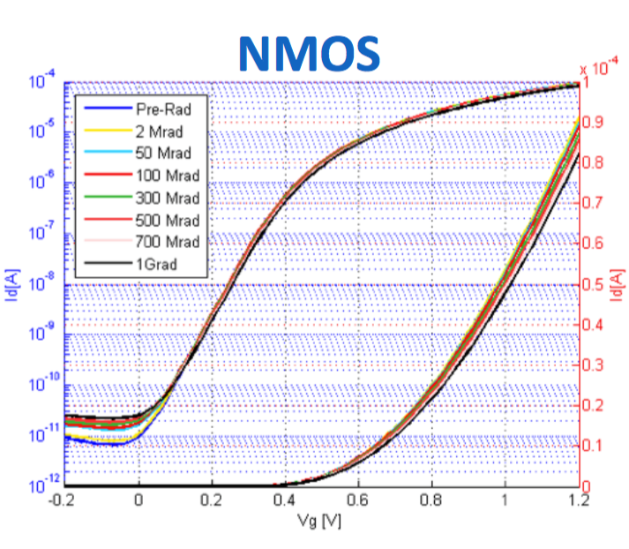
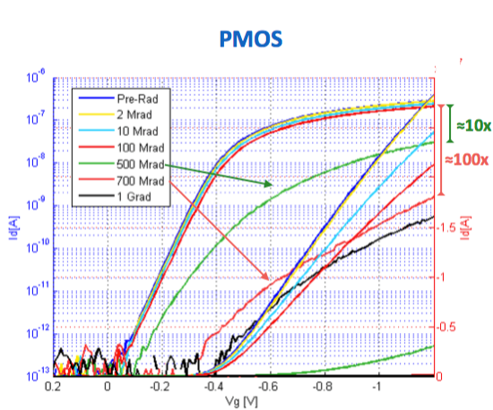
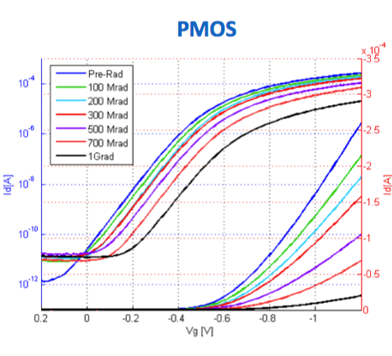
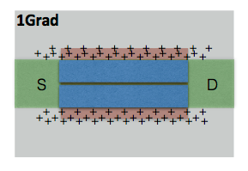
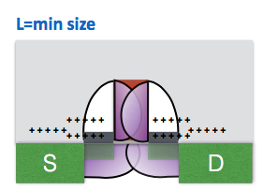
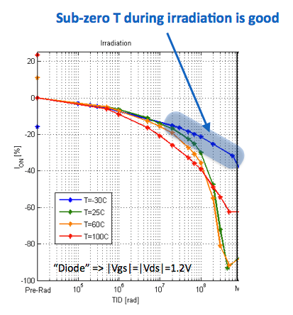
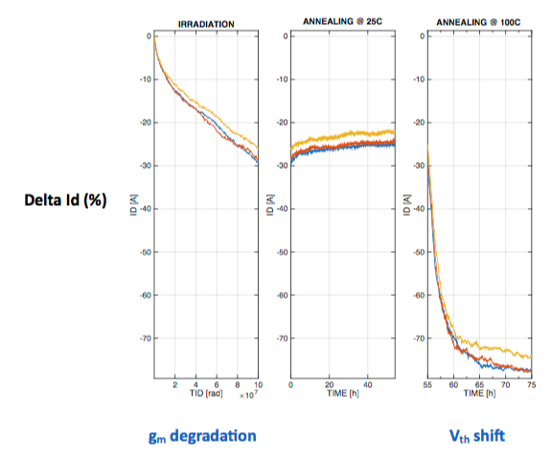
A few radiation effects plots
L=1000, W=1000
L=1000n, W=120n
L=1000n, W=120n
L=60n, W=1000n
Radiation Induced Narrow Channel Effect: RINCE (known)
Radiation Induced Short Channel Effect: RISCE (new)
PMOS, L=60n, W=600n
Detrimental annealing effect (new)

Slide 6
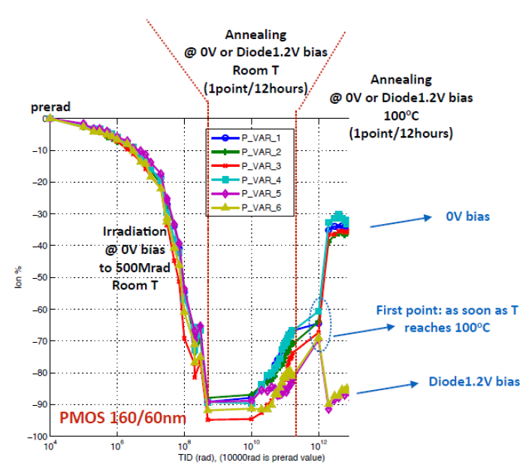
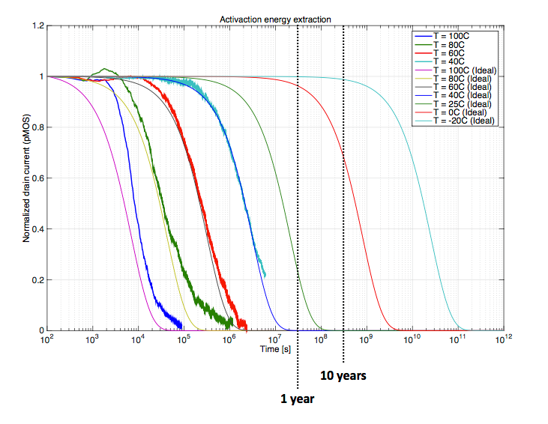
(bad) Annealing
Significant V_{t} shift can develop with annealing depending on Temperature, Time, Bias, Device type, L, W, Received dose,
Foundry specific problem ?
Latest's news: Indication that detrimental effect can be “avoided”/delayed by keeping cold
-20ºC for 10years
Room temp for few months (if unbiased more ?)

Slide 7

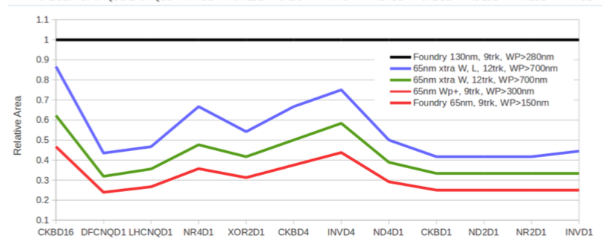
Changing technology ?
High density required in small pixels for hit storage during trigger latency
130nm technology not sufficient density
Other 65nm technologies will now be tested for radiation damage
One technology has been seen to have similar radiation damage, but most likely less detrimental annealing (but not any more available)
Others could be better or worse (unpredictable)
Sub 65nm
Not yet radiation tested to these high levels
Significantly increased cost and complexity
We would be “alone” as no other detectors needs to change technology
Technology access, design kit, support, radiation testing, IPs, shared runs, etc.
RD53 stays with current 65nm technology for large scale demonstrator
Major design efforts invested in this
Appears viable for 500Mrad when taking appropriate precautions
If we are forced to change technology it will take ~1 year to remap design, IPs, FEs, libraries plus extensive radiation testing program will be needed.
Bad combination “avoidance”:
>200Mrad (inner layer),
Replace inner layer(s) after 5 years (5% surface)
Radiation at High/room temperature:
Pixel will run cold (-10 -20ºC)
Small PMOS: High density digital
Only needs to run 40MHz
Analog and Fast Digital circuits:
Dedicated designs with large transistors
High/room temperature anneal
Pixel runs cold
No bias/power when not cooled
Needs to confirm that this “avoidance strategy” is sufficient and reliable

Slide 8
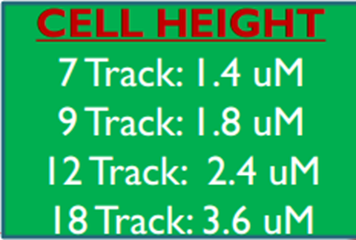
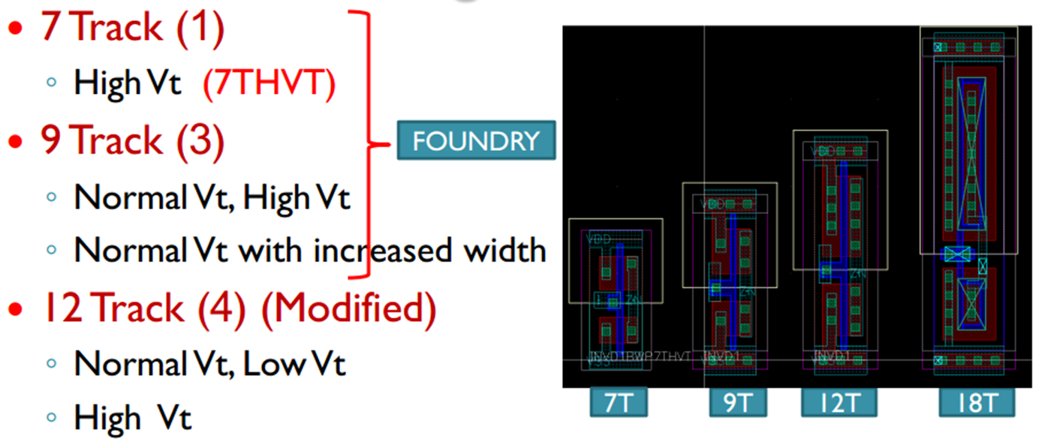
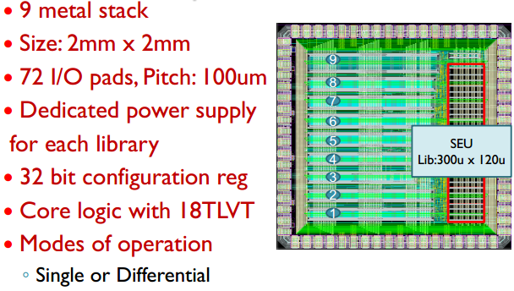
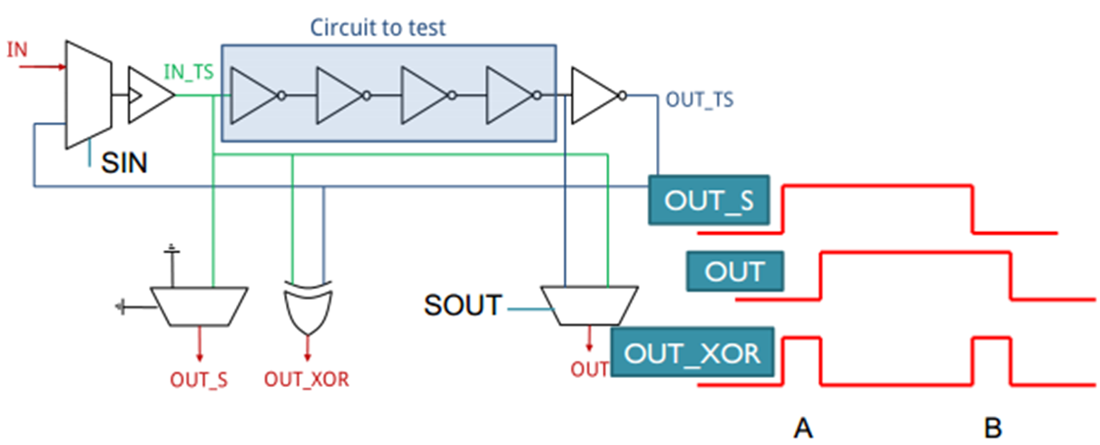
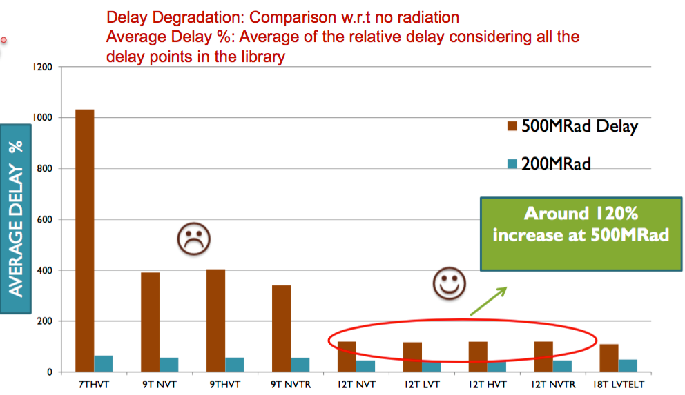
DRAD chip
Dedicated test chip to measure delay degradation and power consumption of digital logic
RD53, MPA, LPGBT
Test structures with different types of gates: NAND, NOR, buffers, flip-flop, latch
SEU test structure
9 different libraries: 7-18 track
Small, Mid, Large transistors
Low Vt, normal Vt, High Vt
Linear, enclosed
Submitted March. 2016
Return: End May
Radiation test campaign during summer
7T-HVt
9T
9T-HVt
9T-incr
12T
12T-LVt
12T-HVt
12T incr
18T-ELT
Some gates (e.g. 4NOR) more affected than others
W
Simulated delay degradation (room temp. radiation)

Slide 9
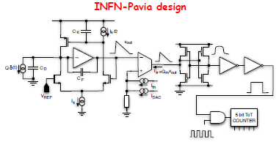
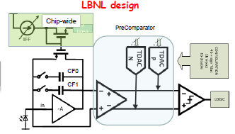
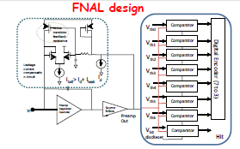
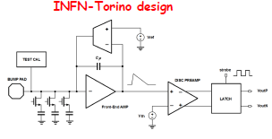
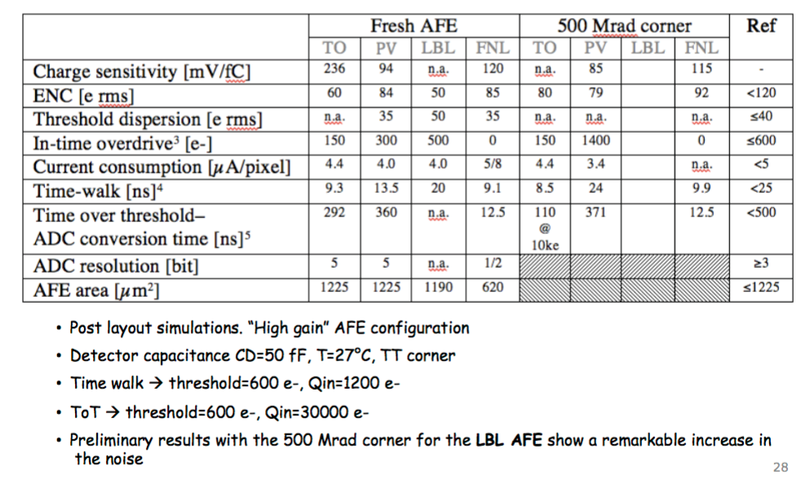
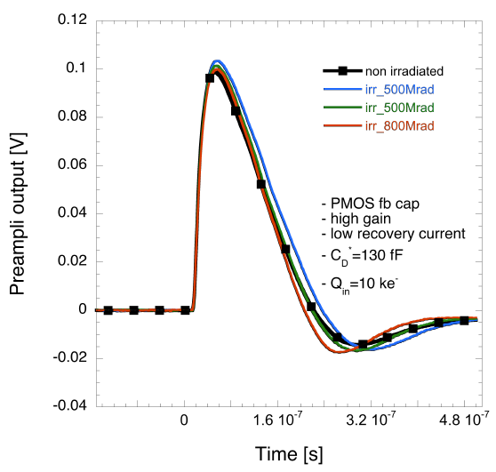
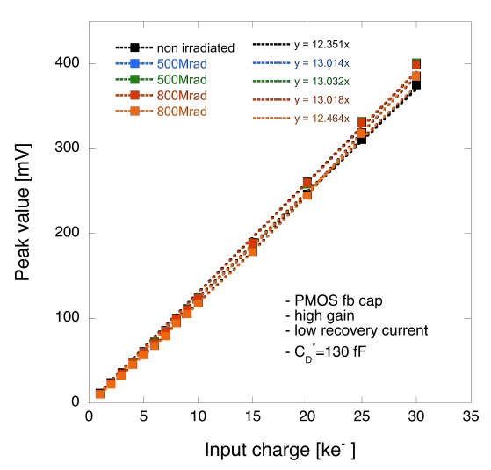
Analog FEs
Low power/noise/area analog pixel Front-Ends
~50% pixel area for analog
Analog front-end specifications defined
Capacitance, threshold, noise, power, dispersion, etc.
Evaluation of alternative FE architectures
3 implementations of TOT FEs
2 slow (40MHz counting) TOT
1 fast (200MHz counting) TOT
1 Non linear fast digitizing FE
3 FEs prototyped and extensively tested
Limited radiation effects

Slide 10
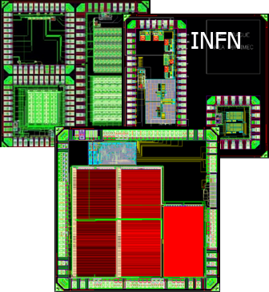
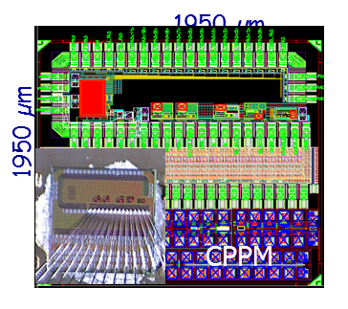
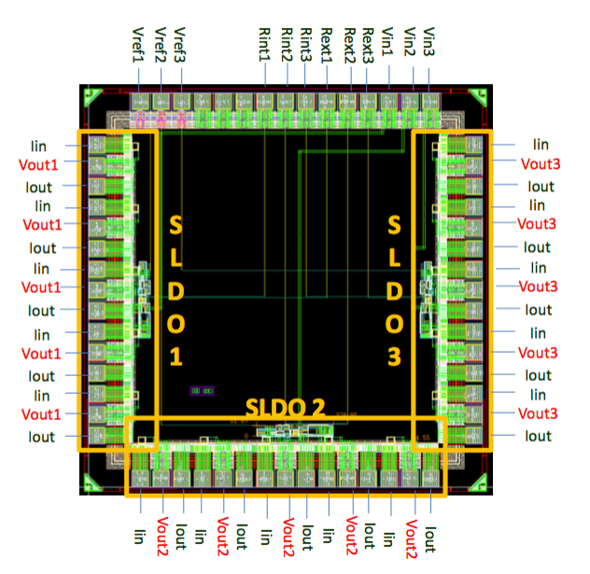
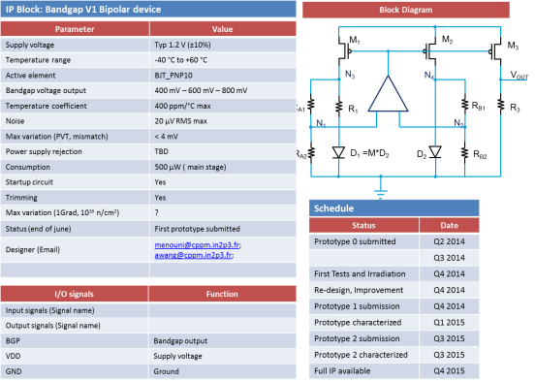
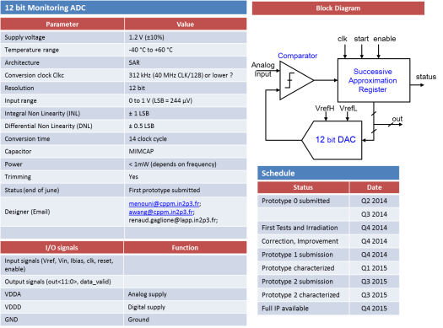
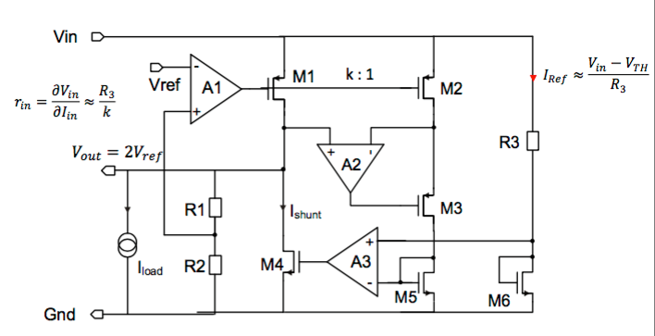
IPs
Building blocks required to build full pixel chip
Large diversity of different IP blocks developed
ADCs, DACs, sensors (temp, current, radiation), Bandgap references, analog buffers, specialized storage cells, PLL, serializers, differential inputs/outputs, shunt-LDO, Power on reset, differential drivers/receivers, etc.
Specs and data sheets defined
IPs prototyped and tested.
Large design effort

Slide 11
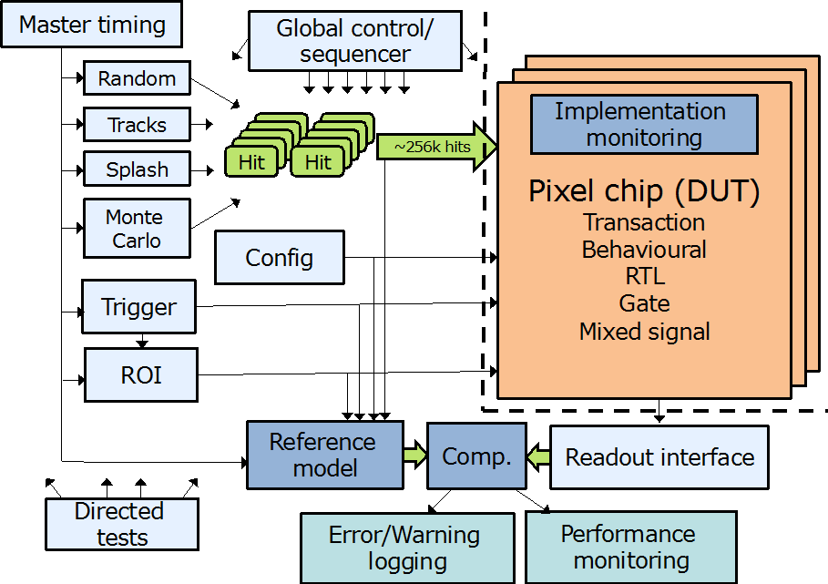
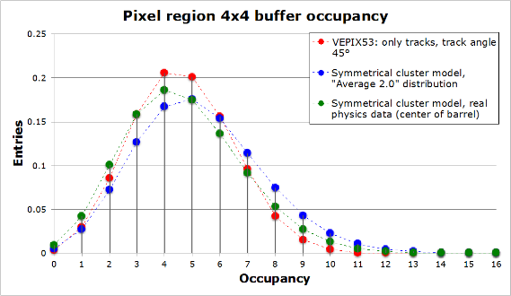
Simulation/verification
Simulation and verification framework for pixel chip
Based on system Verilog and UVM (industry standard for ASIC design and verification)
Available on repository and being used by several groups
Reference model
Basic/generic pixel chip
Detailed RTL/gate level implementations
Integration with ROOT to import hits from detector simulations and for monitoring and analysing results.
Simulation of alternative architectures with Monte Carlo data and/or internally generated hits
Performance characterization of different architectures
Verification of small scale prototypes
Power profiling under different conditions (hits, trigger)
Plans
Inclusion of SEU simulation/verification
Detailed verification of demonstrator chip
25x100um² pixels
Buffer occupancy comparison between
simulation and analytical statistical model

Slide 12
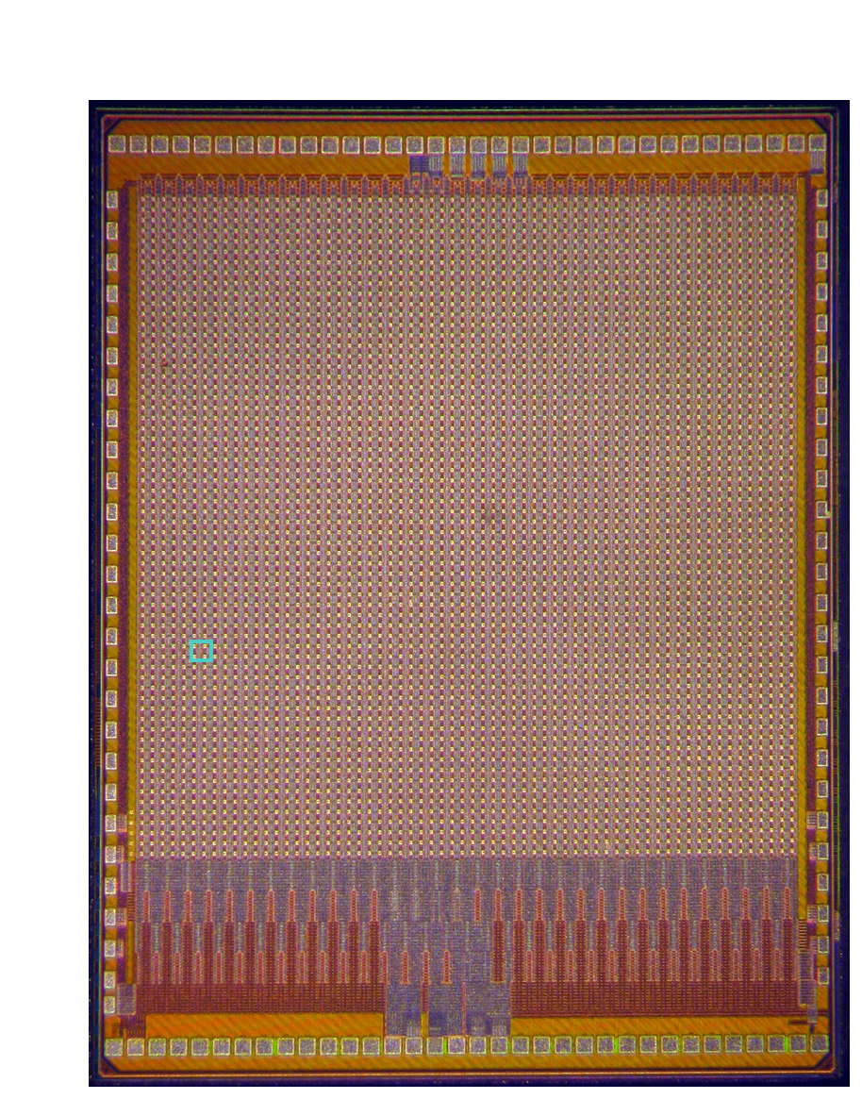
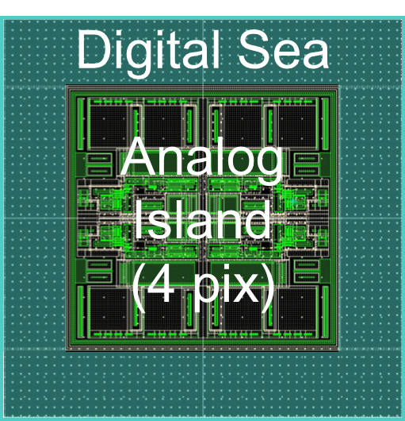
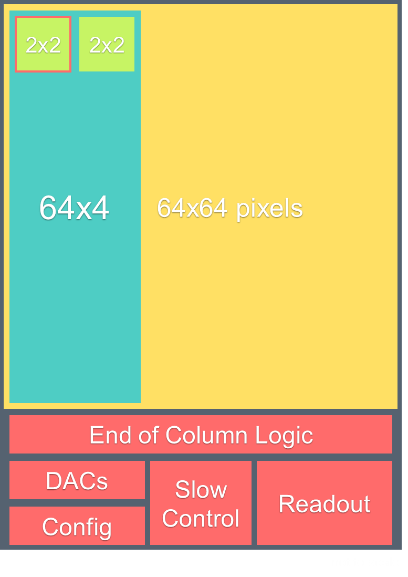
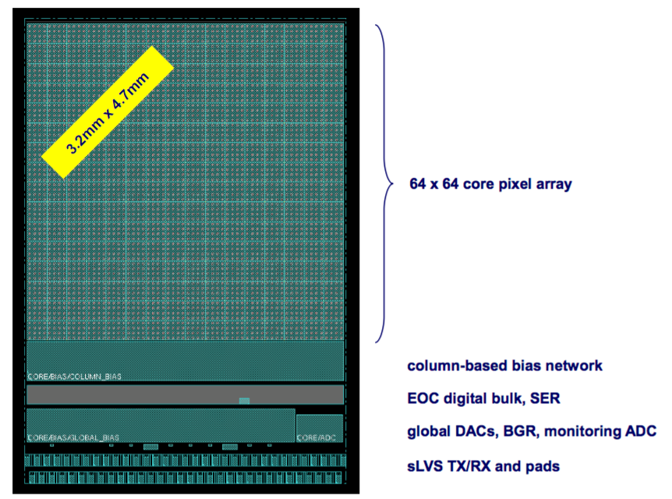
Pixel array prototypes
FE65-P2: 64 x 64 pixels
2 x 2 pixel region (evolution from FEI4)
Low rate readout
Double Analog / Digital isolation
4b-ToT with slow (40MHz) FE
Status: Functional, Under test. Bump bonding to pixel sensor on-going.
CHIPIX65: 64 x 64 pixels
4 x 4 Pixel Region
Single Analog / Digital isolation
5b-ToT with slow and fast FEs
Includes multiple RD53 IP-blocks
Status: Submission June 2016
RD53A: 400 x 400(200) pixels
Status: Under design

Slide 13
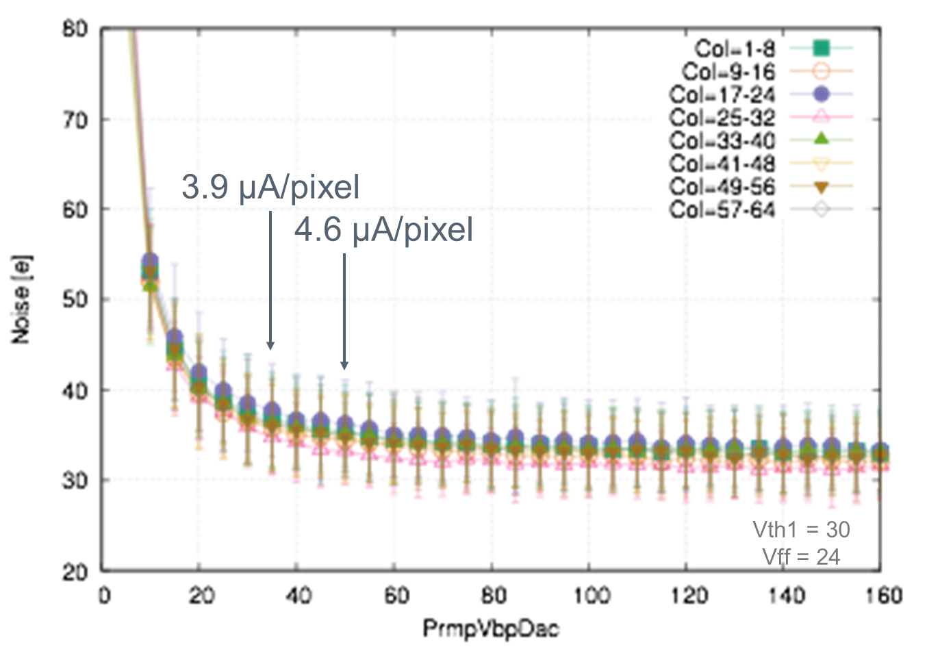
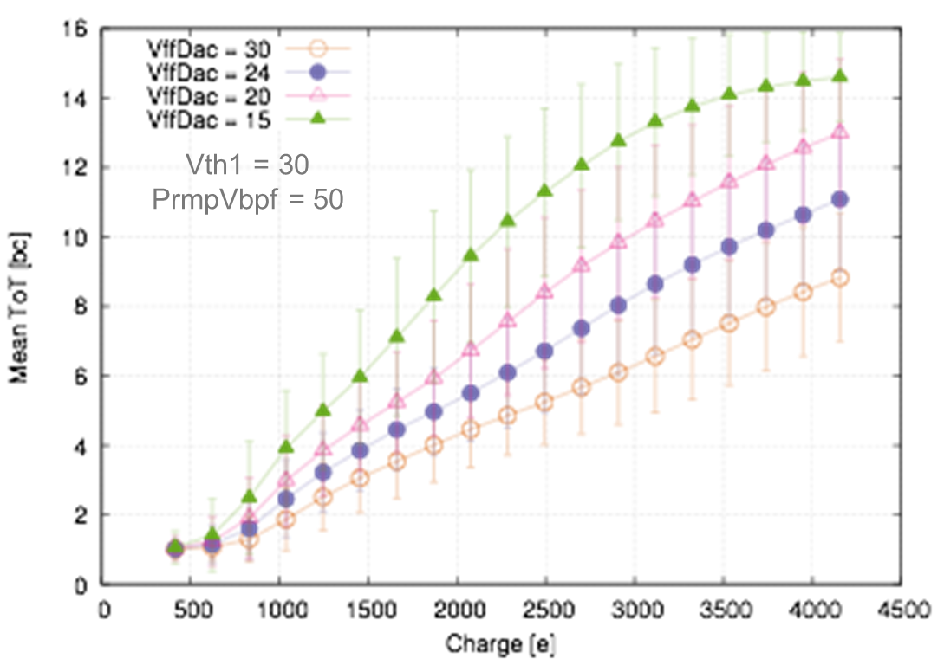
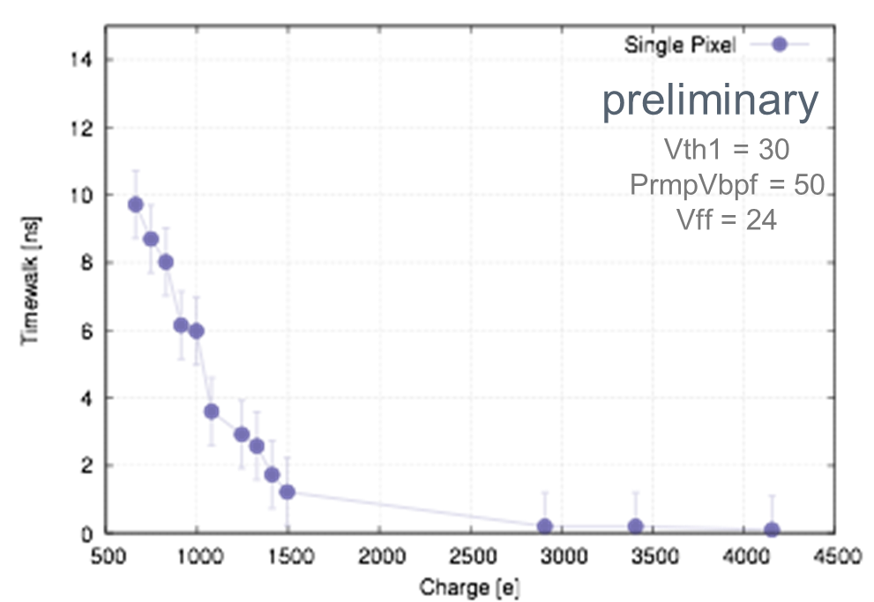
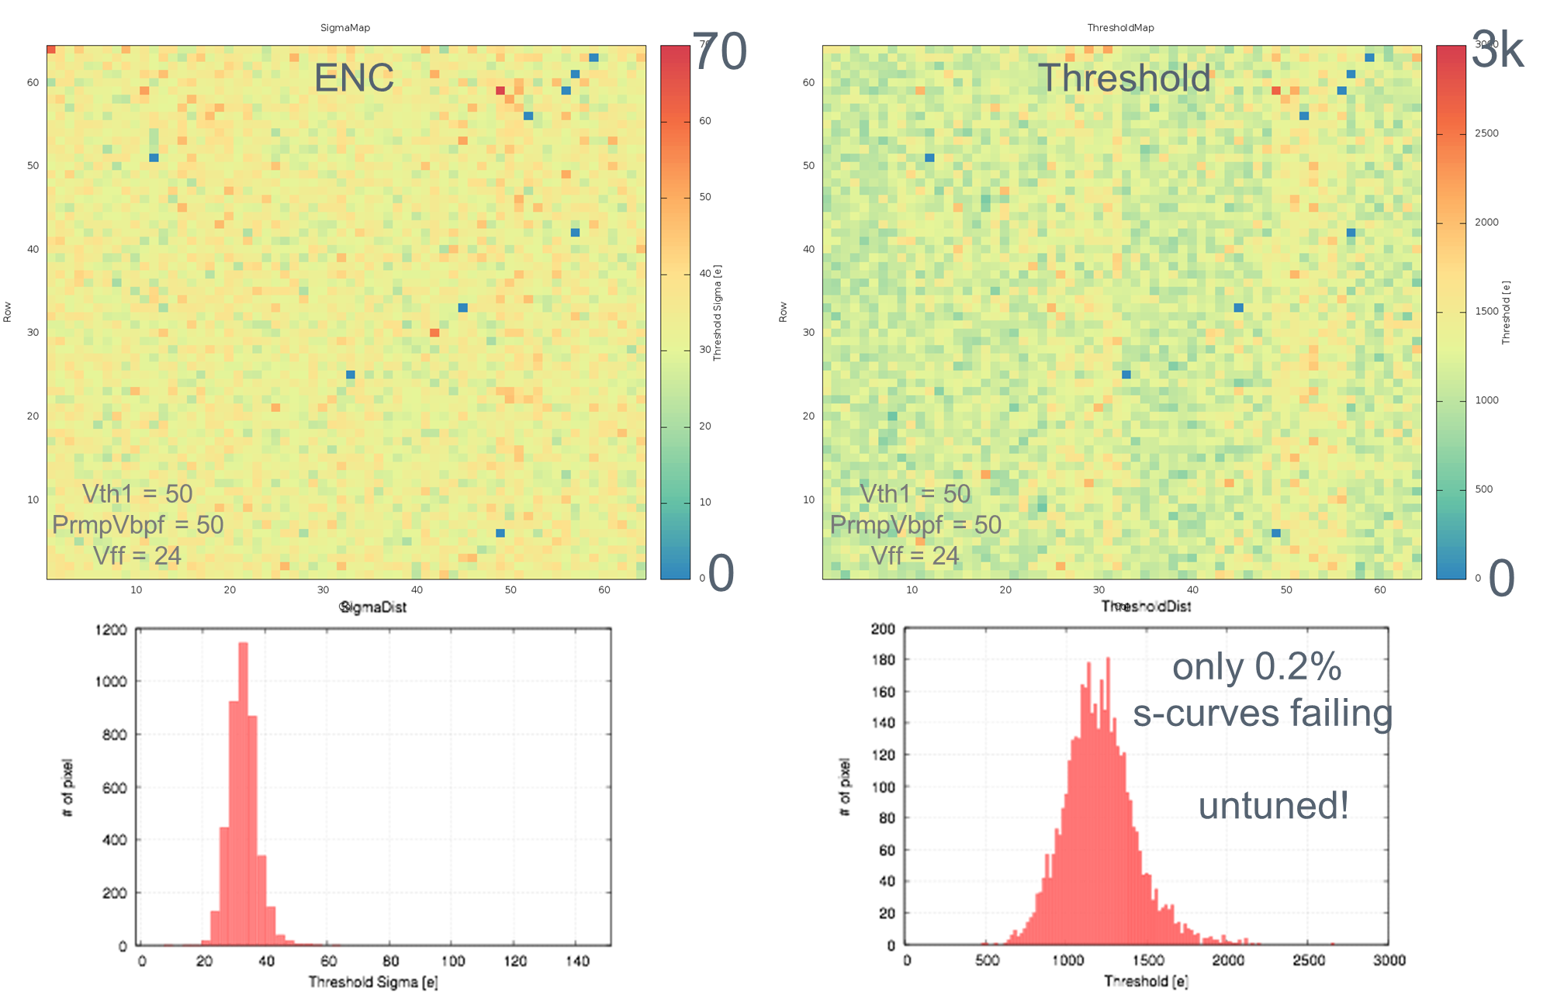
FE65-P2 test results
Before radiation
After 350Mrad

Slide 14
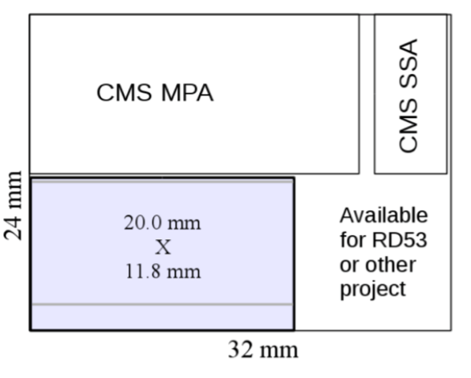
RD53A
Demonstrator chip:
Full size chip: ~2cm x 1(2)cm), small pixels (50x50um²), Large pixels, Very high hit and trigger rates, Radiation and SEU tolerance, Effective in-time threshold: 1200e-, Low power, Serial powering, Functional in test beams, etc.
Specification document agreed with CMS and ATLAS phase 2 pixel communities.
Pixel sensors compatible with this chip being prepared in both ATLAS and CMS
Engineering run ~1M$ (we better get this right !)
Shared run with other project(s) (CMS MPA)
Demonstrator will be ~1/2 size, but designed as being full size
Starting to collect required funds (500k$)
Converge all activities in RD53 and WGs on this vital goal/milestone
Schedule:
Up-scaling small demonstrator: Now
First version of near final chip: Q3 2016
Final version: Q4 2016
(plus some months for extensive verifications)
Core design team: ~10 and increasing
Weekly design meetings since the beginning of the year.
Regular 1-2 days getting together
Defined project structure and responsibilities
Groups: INFN, Bonn, LBNL, Marseilles, NIKHEF, CERN

Slide 15
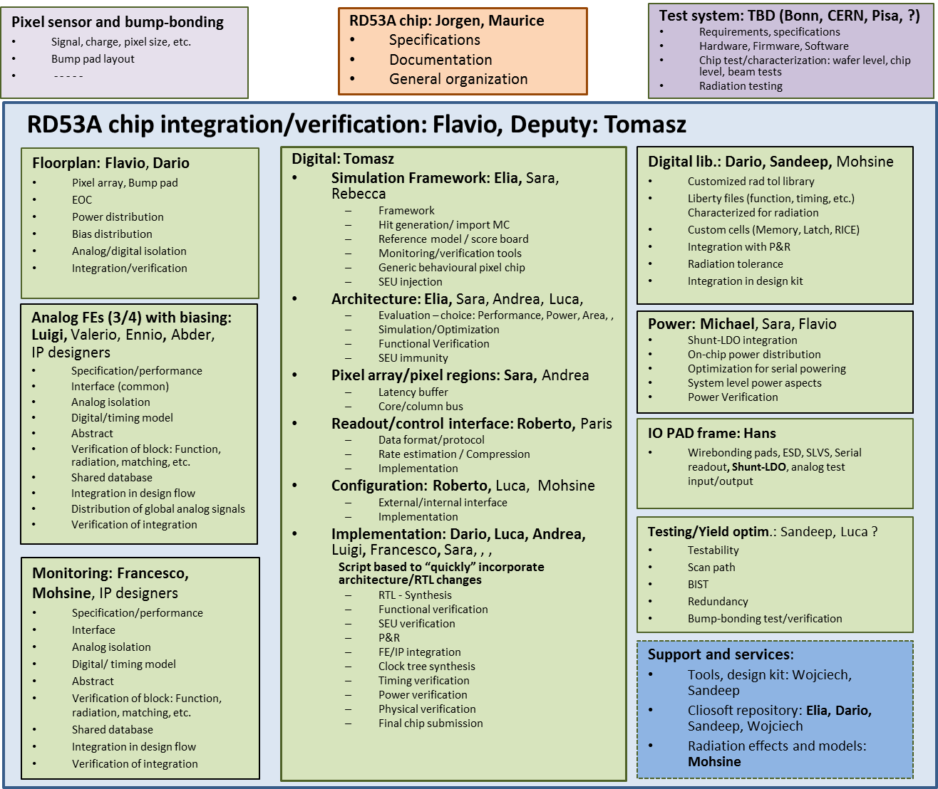
RD53A project structure

Slide 16
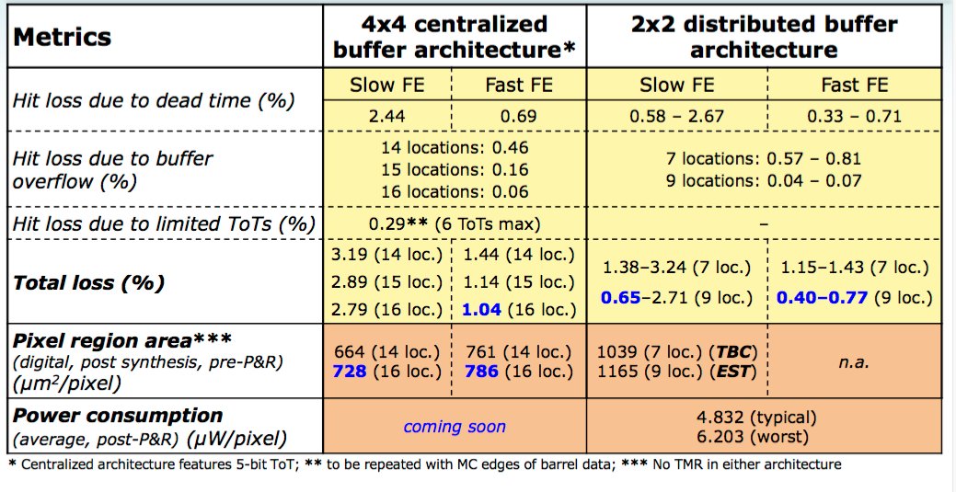
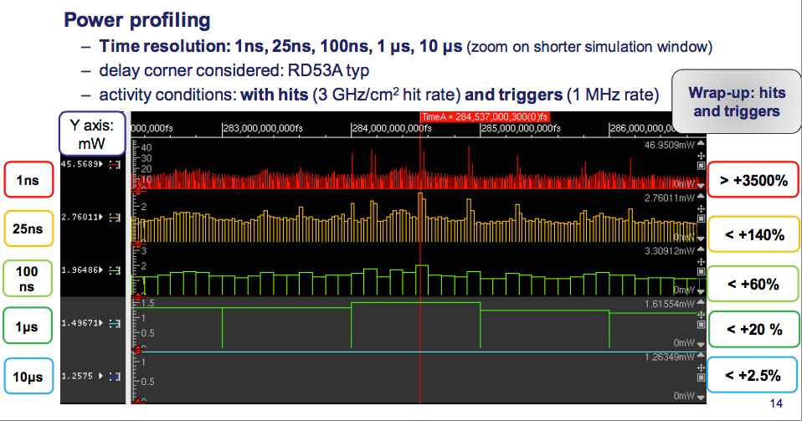
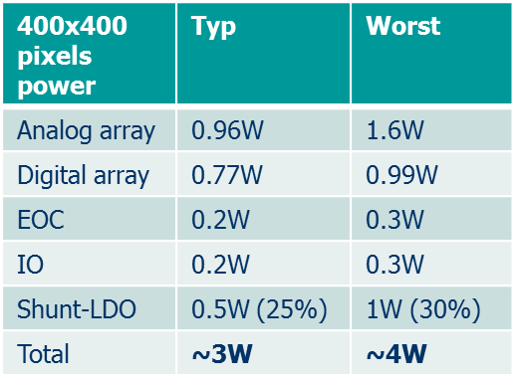
RD53A status
On-going:
Architecture simulations and optimization using Monte Carlo hit data from experiments.
Global floor plan: Upscaled small demonstrator
Shared repositories: IPs, FEs, RTL code, Simulation, full design
Optimization of design flow & tools for very large complex design
Integration of FEs (4) with biasing and required adaptions
Integration of monitoring: ADC, Temp sensor, voltages, currents, etc.
Integration of serial powering
Distributed power dissipation, power profiling, decoupling, system simulations
Integration of IO pad frame
Digital: RTL coding and technology mapping
Pixel array: Optimization (power, size, radiation tolerance)
EOC: Command decoder, chip configuration, readout data formatting, data compression
Synthesis and timing optimization/verification with radiation effects
Verification framework
To come:
SEU optimisation and verification
Final integration
Extensive Analog and digital verification
DRC verification
Submission

Slide 17
Summary
Many groups and people working on a focussed R&D effort to implement very high rate pixel chip for extreme radiation
Large number of circuits, building blocks and small pixel arrays have been successfully prototyped and tested in 65nm technology.
Improved understanding of the initially “mysterious” radiation effects seen at extreme radiation levels above 100Mrad
Many circuits and devices radiation tested
500Mrad appears as realistic goal
Test of full pixel chip will determine if 1Grad is feasible when cold
Focussed on submitting full scale demonstrator chip
Building blocks available and tested
Extensive experience gained with small pixel array prototypes
Defined design team with weekly meetings
Submission: ~End 2016

Slide 18
Backup slides

Slide 19
More information
RD53 collaboration meetings: https://indico.cern.ch/category/5036/
ACES: https://indico.cern.ch/event/468486
RD53 + ATLAS and CMS phase 2 pixel upgrades
Radiation seminar: https://indico.cern.ch/event/442426/
Conferences/workshops
Coming conferences/workshops
Pixel, Vertex, TWEPP, IWORD, FE workshop

Slide 20
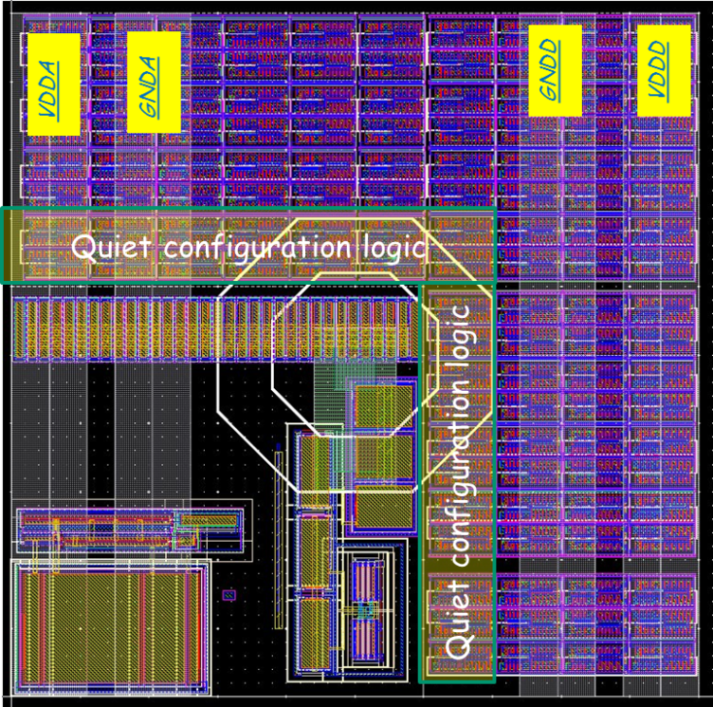
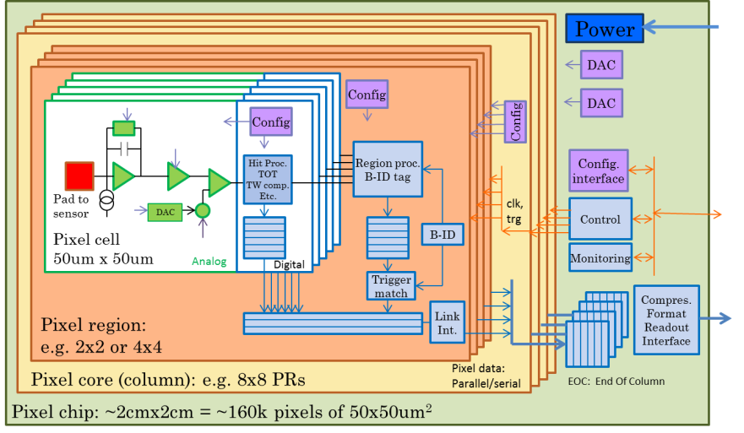
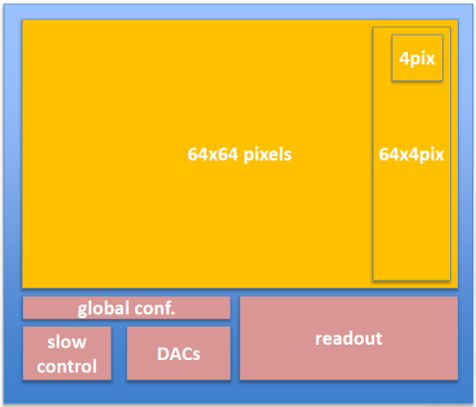
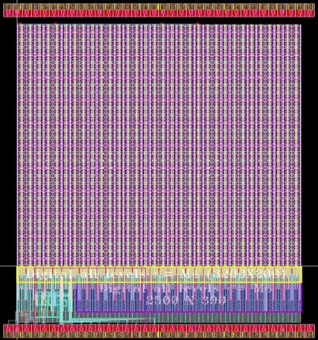
Top level WG
Architecture and floor-plan for large pixel chip
Digital sea with analog islands floorplan
Distribution of power and global signals
Analog – Digital isolation
Digital “on-top” design flow
Pixels – Pixel regions – Pixel cores – End of column
Implementation of small 64x64 pixel demonstrator in 65nm (submission end of this month)
Re-optimized “FEI4” for small pixels, higher hit and trigger rates.
Plans
Refinement of pixel chip (digital) architecture
Using simulation framework
Integration of full pixel chip demonstrator
RD53A

Slide 21
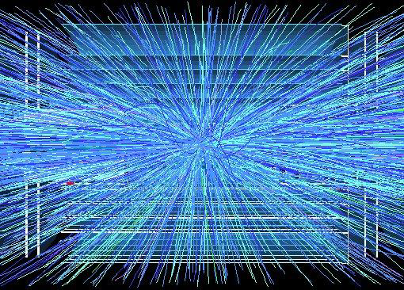
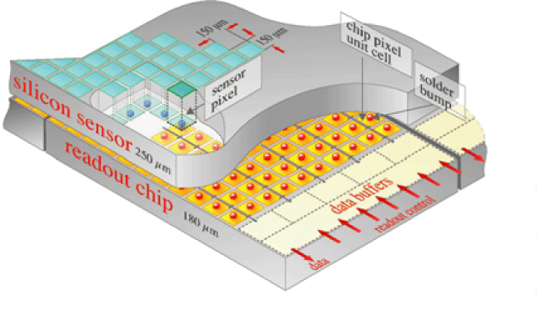


Phase 2 pixel challenges
ATLAS and CMS phase 2 pixel upgrades very challenging
Very high particle rates: 500MHz/cm²
Hit rates: 2-3 GHz/cm² (factor 16 higher than current pixel detectors)
Smaller pixels: ¼ - ½ (25 – 50 um x 100um)
Increased resolution
Improved two track separation (jets)
Participation in first/second level trigger ?
40MHz extracted clusters (outer layers) ?
Region of interest readout for second level trigger ?
Increased readout rates: 100kHz -> 1MHz
Low mass -> Low power
Very similar requirements (and uncertainties) for ATLAS & CMS
Unprecedented hostile radiation: 1Grad, 2 10¹⁶ Neu/cm²
Hybrid pixel detector with separate readout chip and sensor.
Phase2 pixel will get in 1 year what we now get in 10 years
Pixel sensor(s) not yet determined
Planar, 3D, Diamond, HV CMOS, , ,
Possibility of using different sensors in different layers
Final sensor decision may come relatively late.
Very complex, high rate and radiation hard pixel readout chips required
ATLAS HVCMOS program

Slide 22



Radiation effects
Birds beak parasitic device
Spacer dielectrics may be radiation-sensitive
Charge buildup in gate oxide and interface states affects Vt
Thick Shallow Trench Isolation Oxide (~ 300 nm); radiation-induced charge-buildup may turn on lateral parasitic transistors and affect electric field in the channel)
Doping profile along STI sidewall is critical; doping increases with CMOS scaling, decreases in I/O devices
Increasing sidewall doping makes a device less sensitive to radiation (more difficult to form parasitic leakage paths)

Slide 23
Pixel chip generations
Generation | Current FEI3, PSI46 | Phase 1 FEI4, PSI46DIG | Phase 2
Pixel size | 100x150um² (CMS) 50x400um² (ATLAS) | 100x150um² (CMS) 50x250um² (ATLAS) | 25x100um² ?
Sensor | 2D, ~300um | 2D+3D (ATLAS) 2D (CMS) | 2D, 3D, Diamond, MAPS ?
Chip size | 7.5x10.5mm² (ATLAS) 8x10mm² (CMS) | 20x20mm² (ATLAS) 8x10mm² (CMS) | > 20 x 20mm²
Transistors | 1.3M (CMS) 3.5M (ATLAS) | 87M (ATLAS) | ~1G
Hit rate | 100MHz/cm² | 400MHz/cm² | 2(3) GHz/cm²
Hit memory per chip | 0.1Mb | 1Mb | ~16Mb
Trigger rate | 100kHz | 100KHz | 200kHz - 1MHz
Trigger latency | 2.5us (ATLAS) 3.2us (CMS) | 2.5us (ATLAS) 3.2us (CMS) | 6 - 20us
Readout rate | 40Mb/s | 320Mb/s | 1-4Gb/s
Radiation | 100Mrad | 200Mrad | 1Grad
Technology | 250nm | 130nm (ATLAS) 250 nm (CMS) | 65nm
Architecture | Digital (ATLAS) Analog (CMS) | Digital (ATLAS) Analog (CMS) | Digital
Buffer location | EOC | Pixel (ATLAS) EOC (CMS) | Pixel
Power | ~1/4 W/cm² | ~1/4 W/cm² | ½ - 1 W/cm²

Slide 24
Working groups
WG | Domain
WG1 | Radiation test/qualification
Coordinate test and qualification of 65nm for 1Grad TID and10¹⁶ neu/cm² Radiation tests and reports. Transistor simulation models after radiation degradation Expertise on radiation effects in 65nm
WG2 | Top level
Design Methodology/tools for large complex pixel chip Integration of analog in large digital design Design and verification methodology for very large chips. Design methodology for low power design/synthesis. Clock distribution and optimization.
WG3 | Simulation/verification framework
System Verilog simulation and Verification framework Optimization of global architecture/pixel regions/pixel cells
WG4 | I/O + (Standard cell)
Development of rad hard IO cells (and standard cells if required) Standardized interfaces: Control, Readout, etc.
WG5 | Analog design / analog front-end
Define detailed requirements to analog front-end and digitization Evaluate different analog design approaches for very high radiation environment. Develop analog front-ends
WG6 | IP blocks
Definition of required building blocks: RAM, PLL, references , ADC, DAC, power conversion, LDO, , Distribute design work among institutes Implementation, test, verification, documentation

Slide 25
RD53 collaboration
20 Institutes (Seville has joined)
Bari, Bergamo-Pavia, Bonn, CERN, CPPM, Fermilab, LBNL, LPNHE Paris, Milano, NIKHEF, New Mexico, Padova, Perugia, Pisa, Prague IP/FNSPE-CTU, PSI, RAL, Seville, Torino, UC Santa Cruz.
140 on collaboration Email list
~70 actively contributing
2015 FTE: ~23
50 on RD53 guests email list
Spokes persons: Maurice Garcia-Sciveres, LBNL (ATLAS), Jorgen Christiansen, CERN (CMS)
IB chair: Lino Demaria, Torino
WG conveners: Marlon Barbero, Roberto Beccherle, Jorgen Christiansen, Maurice Garcia-Sciveres, Tomasz Hemperek, Valerio Re
2 year terms coming up to renewal within 3 months
MOU defined and signed (few exceptions)
RD53 collaboration meetings: 2 times per year
RD53 management meetings: Monthly
WG meetings: Monthly – bi-monthly
Activity | FTE 2015
Radiation | 4
Analog | 3
IP | 7
Simulation | 3
Top | 3
IO | 1
Organization | 2
Total | ~23

Slide 26



Radiation effects (PMOS)
Requires an extended
seminar to explain
all this

Slide 27
power
400x400 pixels power | Typ | Worst
Analog array | 0.96W | 1.6W
Digital array | 0.77W | 0.99W
EOC | 0.2W | 0.3W
IO | 0.2W | 0.3W
Shunt-LDO | 0.5W (25%) | 1W (30%)
Total | ~3W | ~4W

